Slide 1
Internet of Things Practical Session
- Vikas Yadav

Slide 2
ESP8266 – 12E (Wi-Fi microchip)
- Why ESP8266, why not my PC, My smartphone ?
- Other variants / alternatives ?

Slide 3
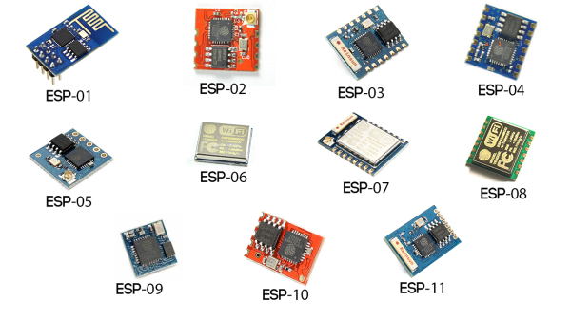
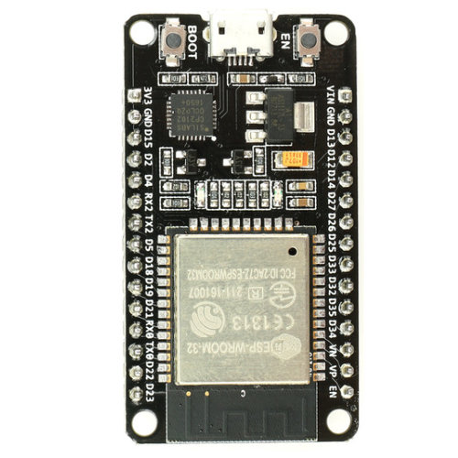
Other Variants
ESP32

Slide 4
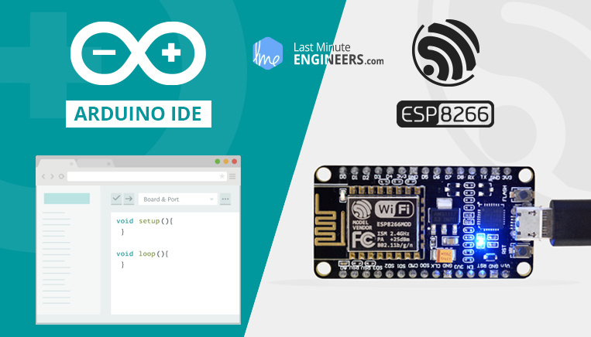
Insight Into ESP8266-12E NodeMCU Features & Using It With Arduino IDE
HatchnHack

Slide 5
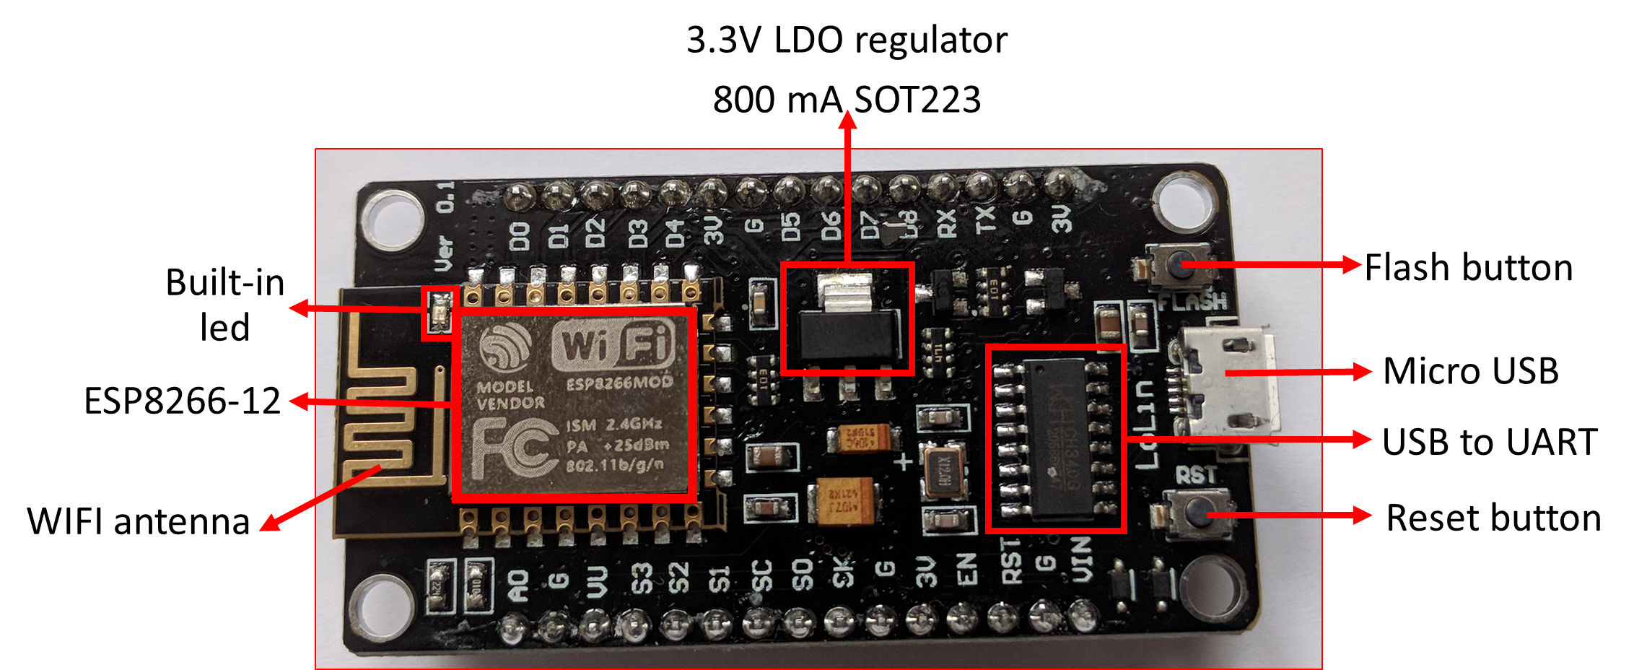
ESP-12E Module

Slide 6
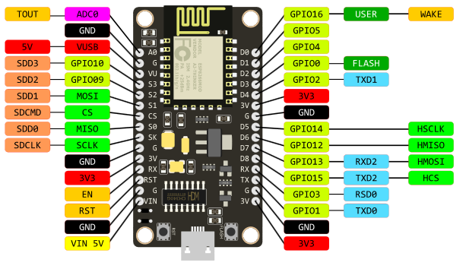
ESP8266-12E Module Pinout

